Slide 2
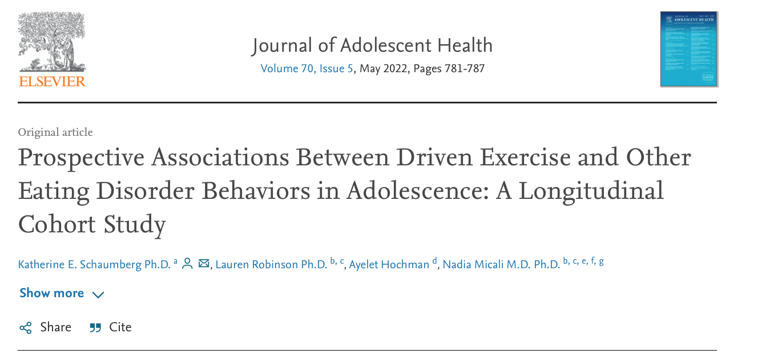
Background
Dysfunctional exercise is a common, debilitating symptom across eating disorders (ED).
e.g. up to 40% of individuals with bulimia nervosa and 80% of those with anorexia nervosa
Dysfunctional exercise relates to:
High levels of ED symptoms
Poor ED treatment outcomes

Slide 3
Background
Common Definitional Components of Maladaptive Exercise:
Feeling ‘driven’ to preform exercise
Having exercise obsessions
Exercising to reduce distress (e.g. guilt, anxiety)
Exercising to prevent weight gain
Exercise leading to functional impairment
It is unclear which aspects of exercise impact onset and exacerbation of eating pathology
Notes:
Weak central coherence – perseveration on details/absence of big picture

Slide 4
Current Study
ALSPAC (age 14 N = 6,140; Age 16 N = 5,069)
Aim : To investigate whether those reporting exercise for weight loss (EWL) or maladaptive exercise, as compared to those who do not report EWL, also present with higher levels of other ED behaviours in adolescence.

Slide 5
Exercise Categorization (Age 14)
Do you exercise?
Do you Exercise to lose weight or avoid gaining weight?
Do you exercise when sick or injured?
OR
Was it hard to do schoolwork or work because of amount of exercise performed?
NO: NO EXERCISE FOR WL
YES
YES
NO: NO EXERCISE FOR WL
NO:
EXERCISE FOR WEIGHT LOSS
YES:
MALADAPTIVE EXERCISE

Slide 7
Analytic Plan
IV
Exercise-based group; No EWL as reference group
Statistical Approach
DVs
ED Behaviors at ages 14 and 16
Covariates
Linear Regression - ED cognitions
Logistic Regression - ED behaviors
Age 14: BMI, ethnicity, maternal education
Age 16: Age 14 BMI, ethnicity, maternal education, Age 14 ED behaviors
Missing Data
Multiple imputation: to account for missing data on sociodemographic variables: child ethnicity (11.0% missing), maternal education (10.9% missing), maternal parity (10.6% missing).

Slide 8
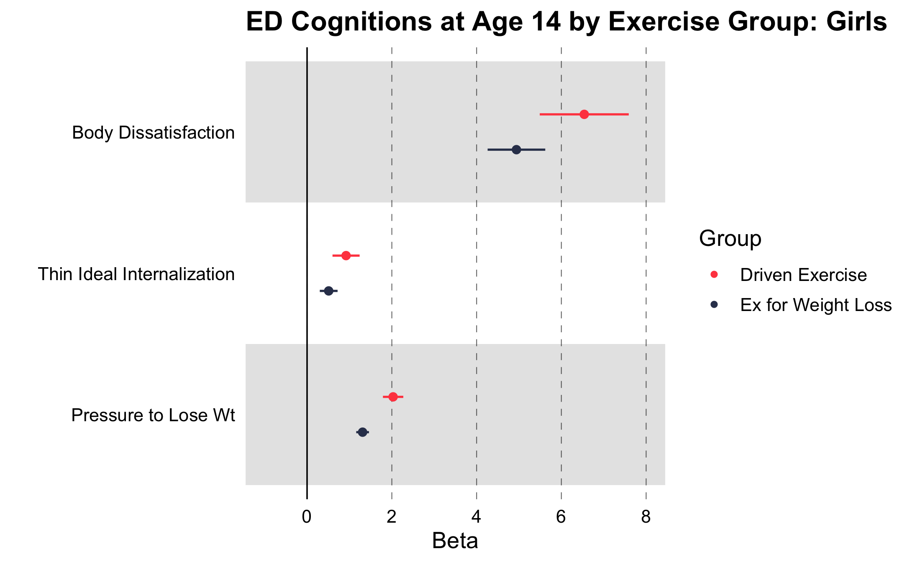
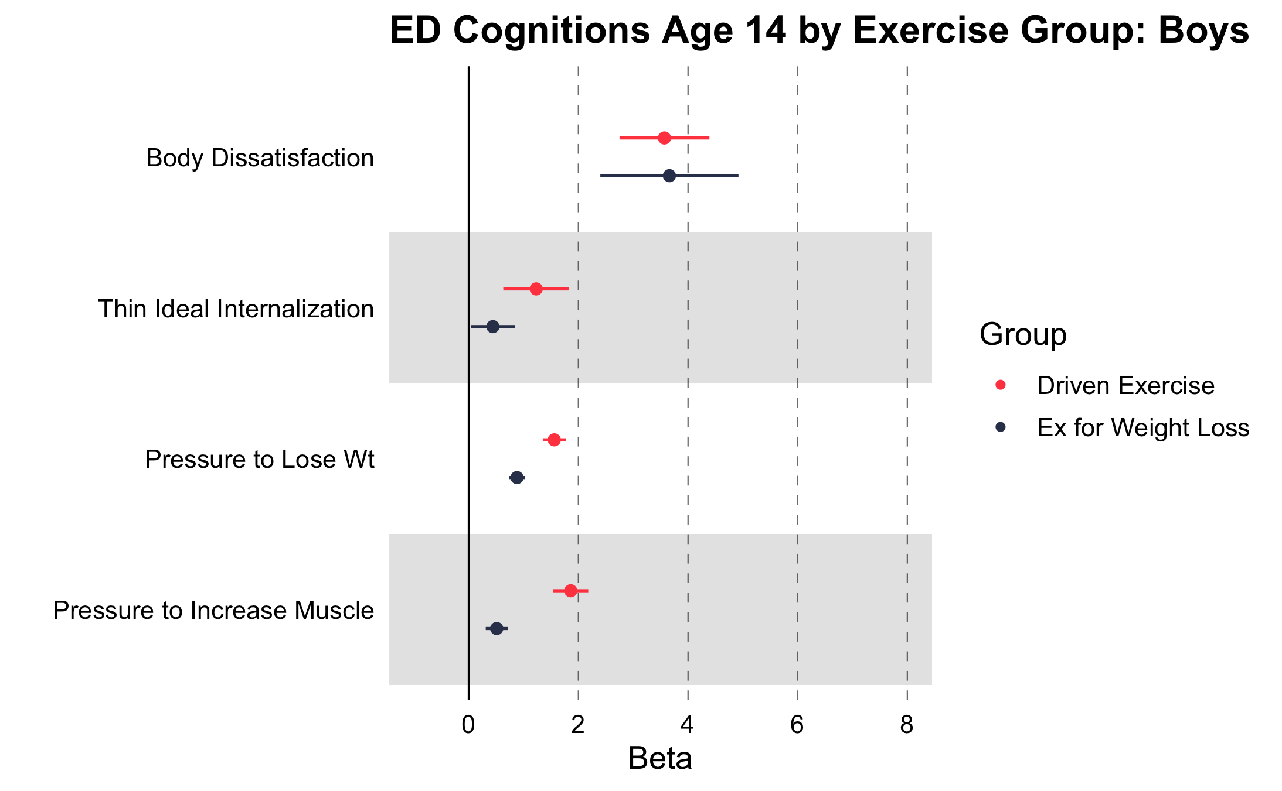
Aim 1: Concurrent associations with ED cognitions
Notes:
Coefficients for the EWL and driven exercise predictors in these models represent relative odds ratios and regression coefficients for these groups in comparison to the no-EWL group. Odds ratios are interpreted as the relative odds of engaging in a specific behavior relative to the no-EWL group. That is, an odds ratio of 2 indicates that individuals in the identified group are twice as likely to report the specified ED behavior, as compared to those in the no-EWL group.

Slide 9
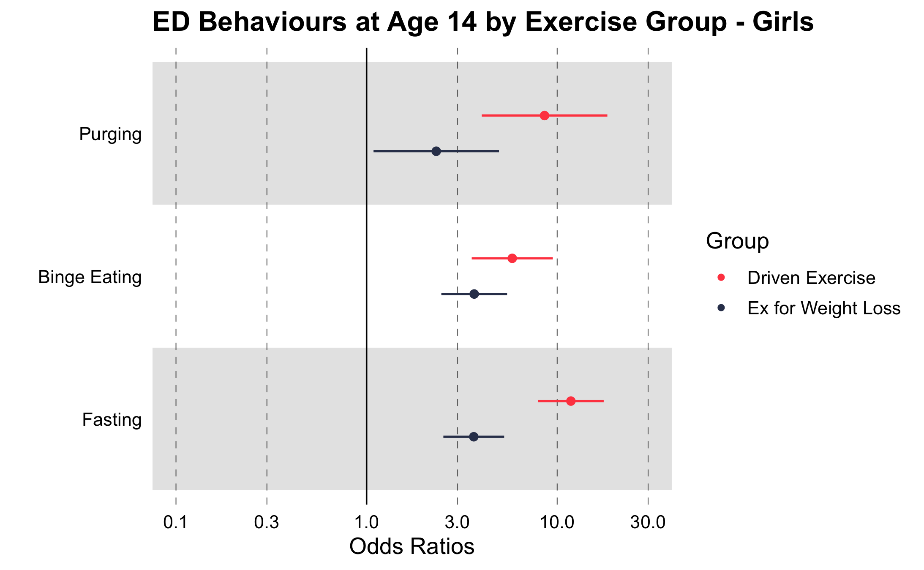
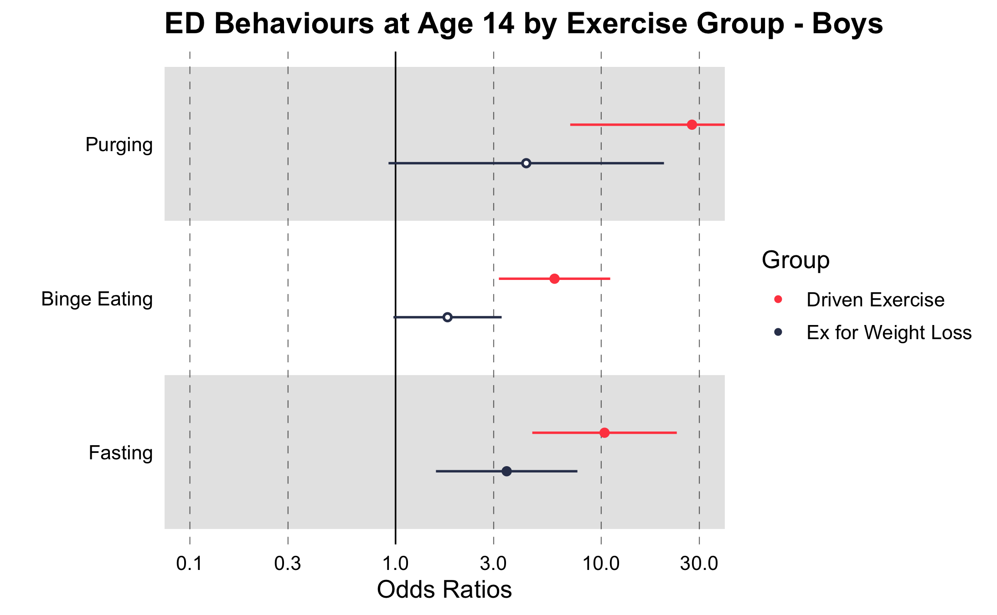
Concurrent associations with ED behaviors

Slide 10
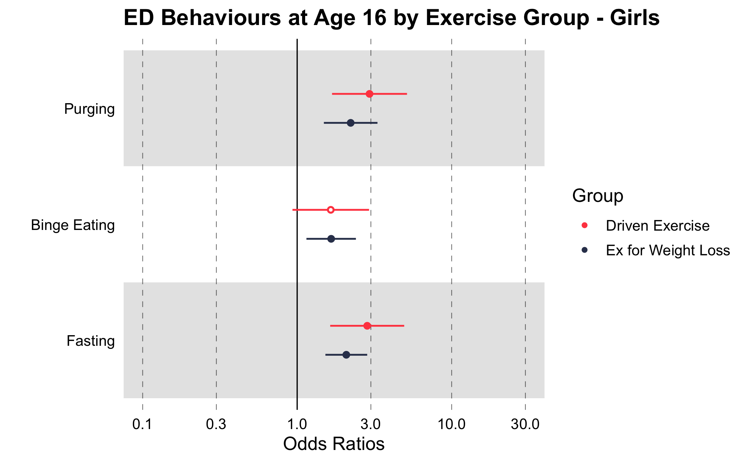
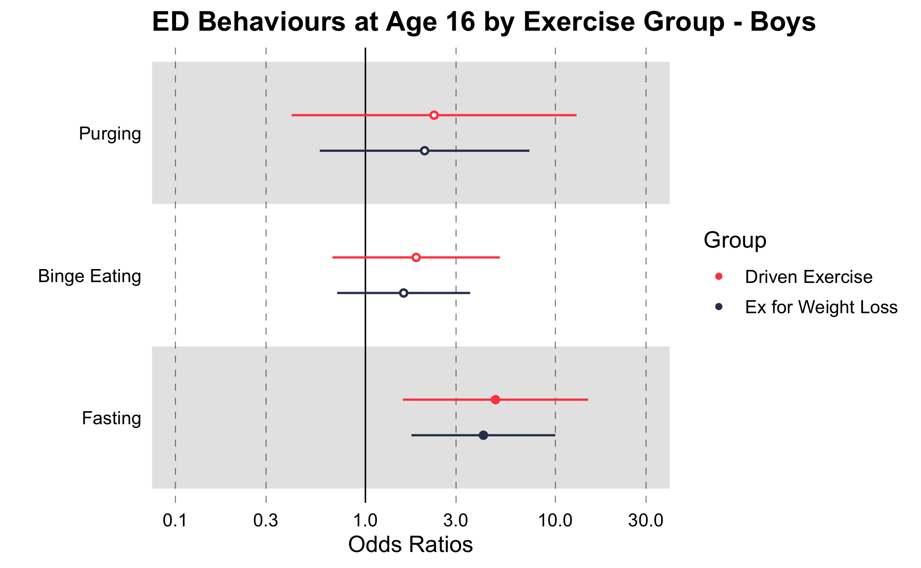
Prospective associations with ED behaviors

Slide 11

No Exercise for Weight Loss
Exercise for Weight Loss
Maladaptive Exercise

Slide 12
Exercise Categorization
Do you exercise?
Do you Exercise to lose weight or avoid gaining weight?
Do you exercise when sick or injured?
OR
Was it hard to do schoolwork or work because of amount of exercise performed?
NO: NO EXERCISE FOR WL
YES
YES
NO: NO EXERCISE FOR WL
NO:
EXERCISE FOR WEIGHT LOSS
YES:
MALADAPTIVE EXERCISE

Slide 13
Maladaptive exercise at age 14 -- Prospective associations with ED behaviors at age 16
Maladaptive Ex
Maladaptive Ex

Slide 14
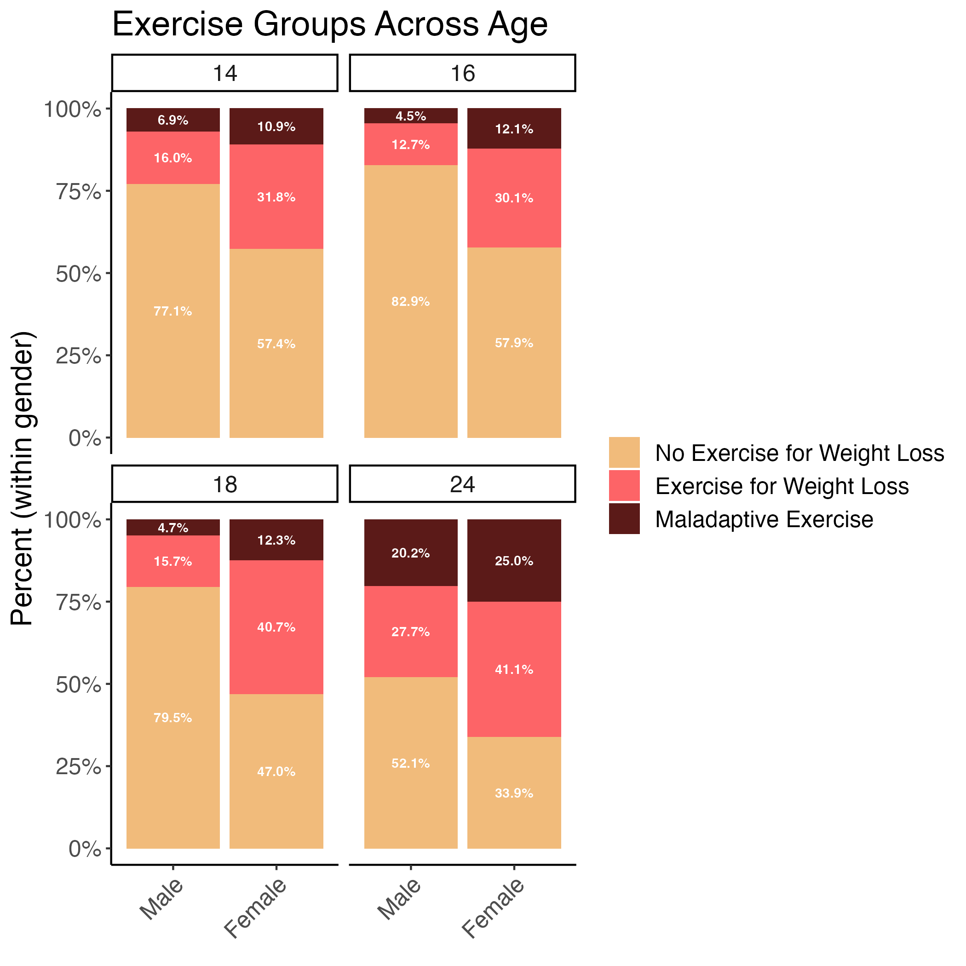
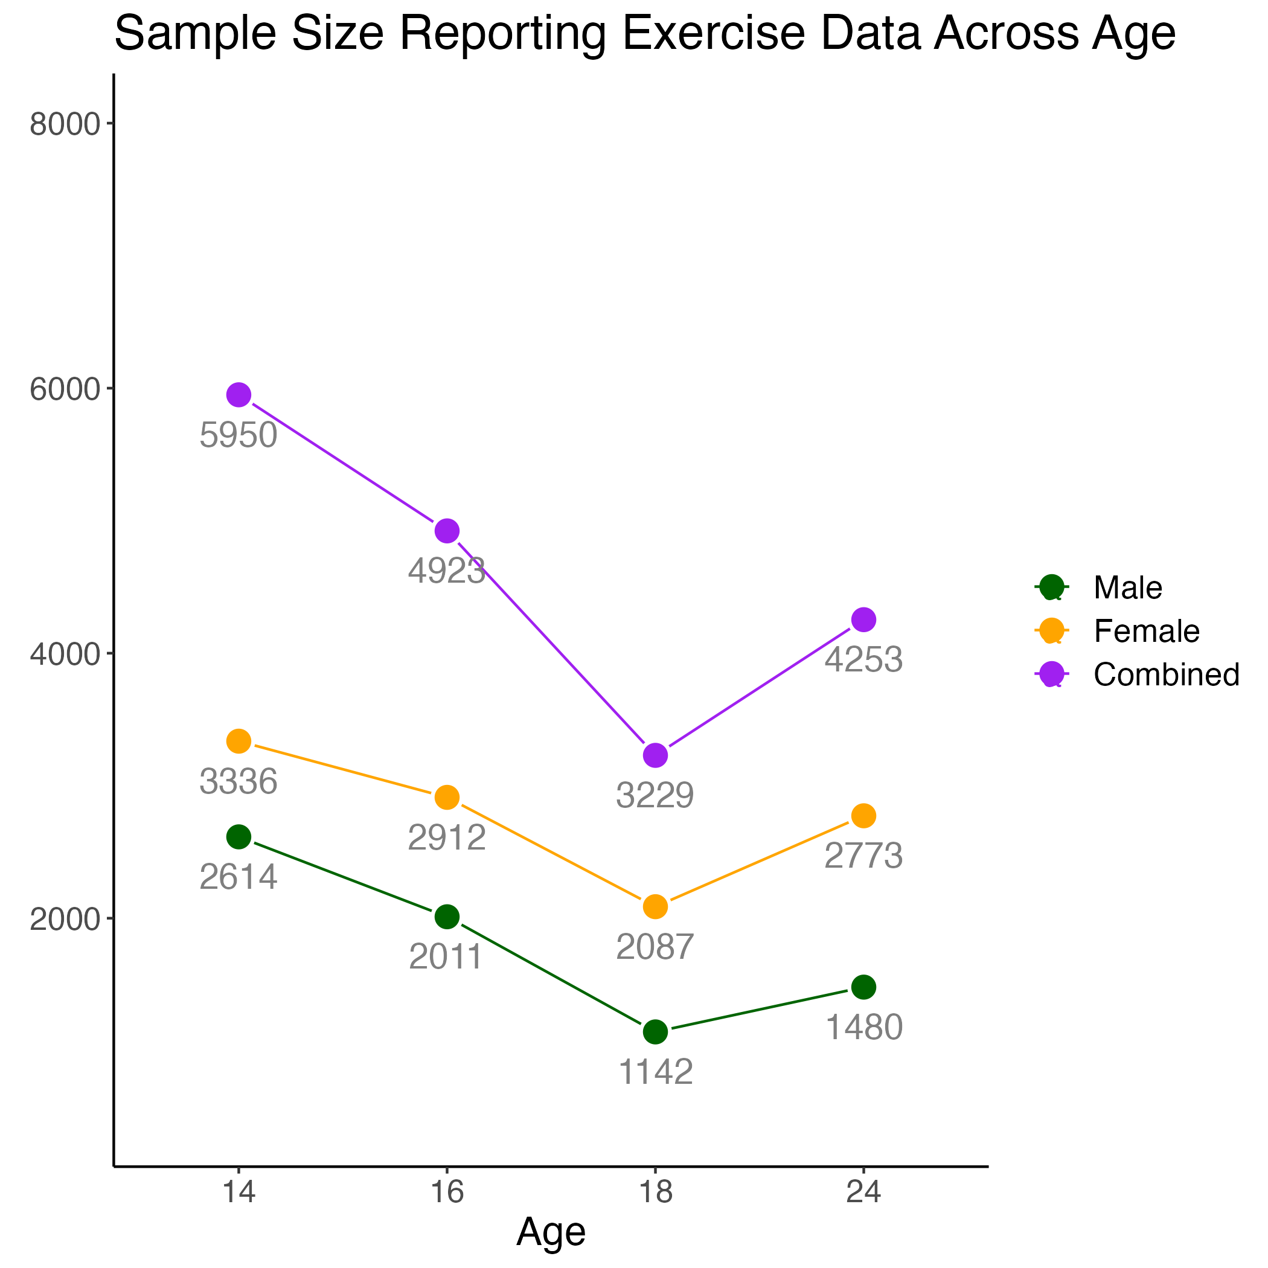

Slide 15
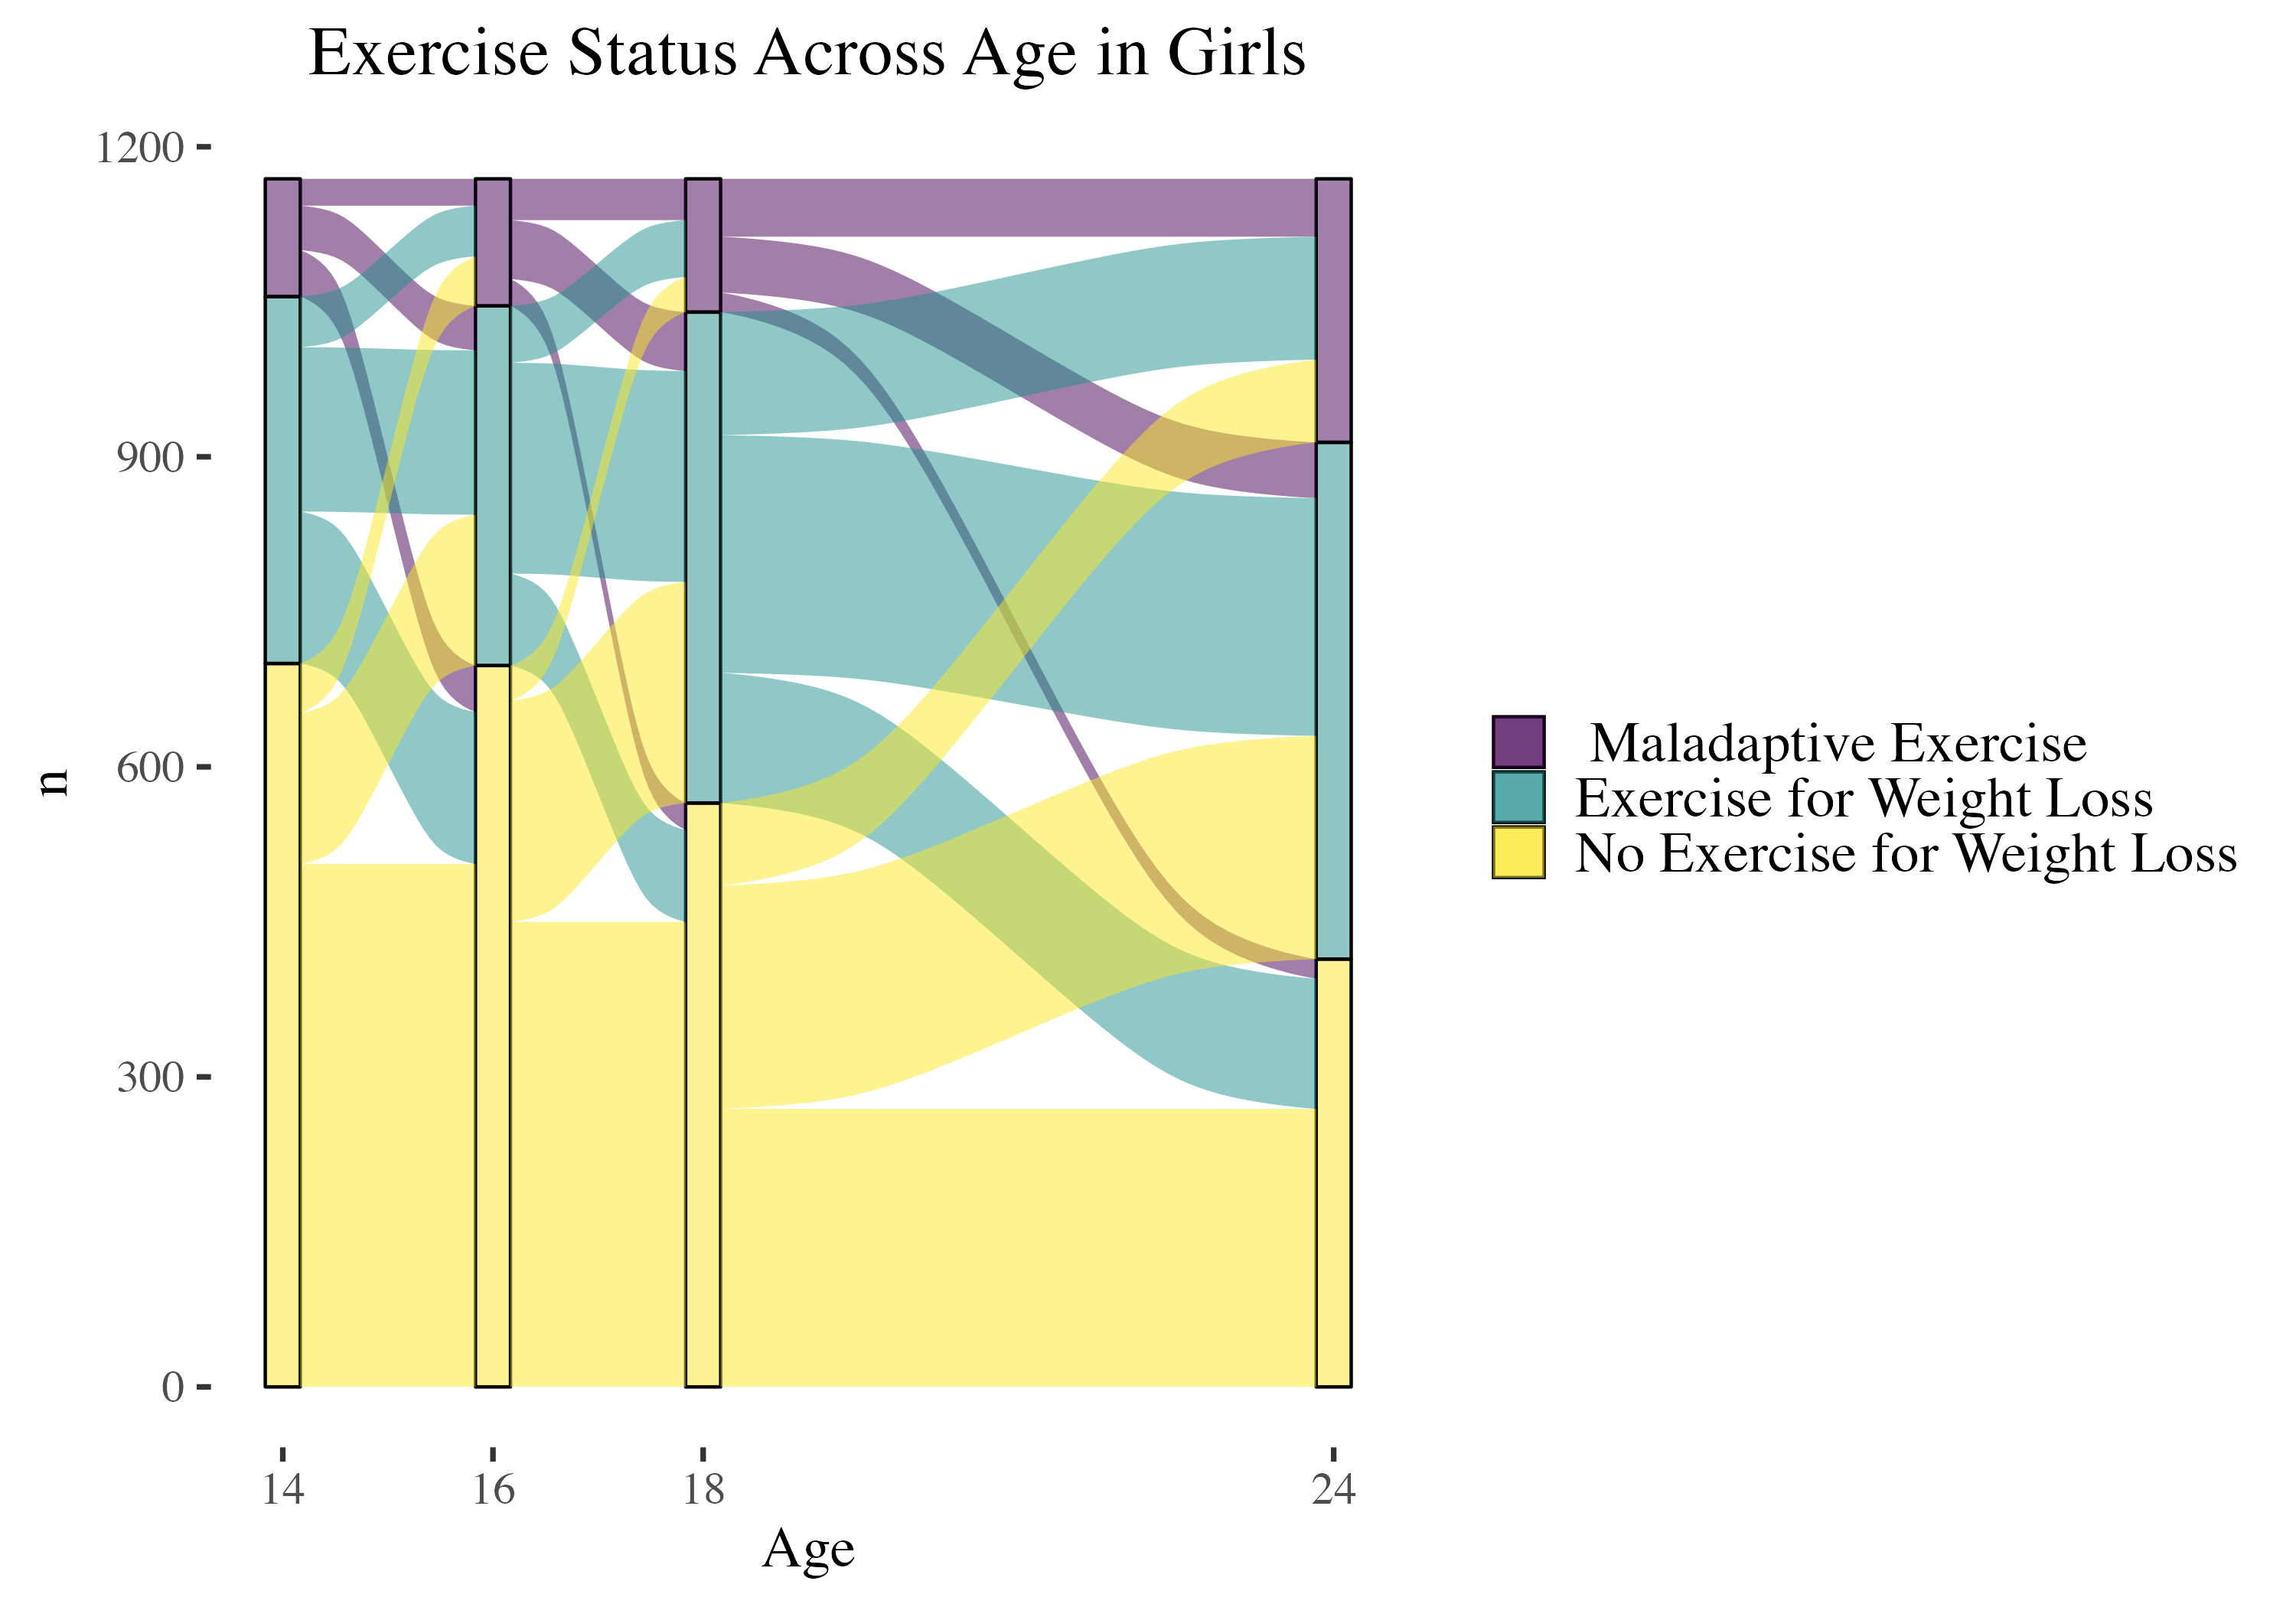
Estimates of Transition Probabilities Across 1-year amongst Girls: From (rows) - To (cols)
 | No EWL | EWL | Maladaptive Exercise
No EWL | 0.79 | 0.19 | 0.02
EWL | 0.16 | 0.68 | 0.17
Maladaptive Exercise | 0.11 | 0.29 | 0.60

Slide 16
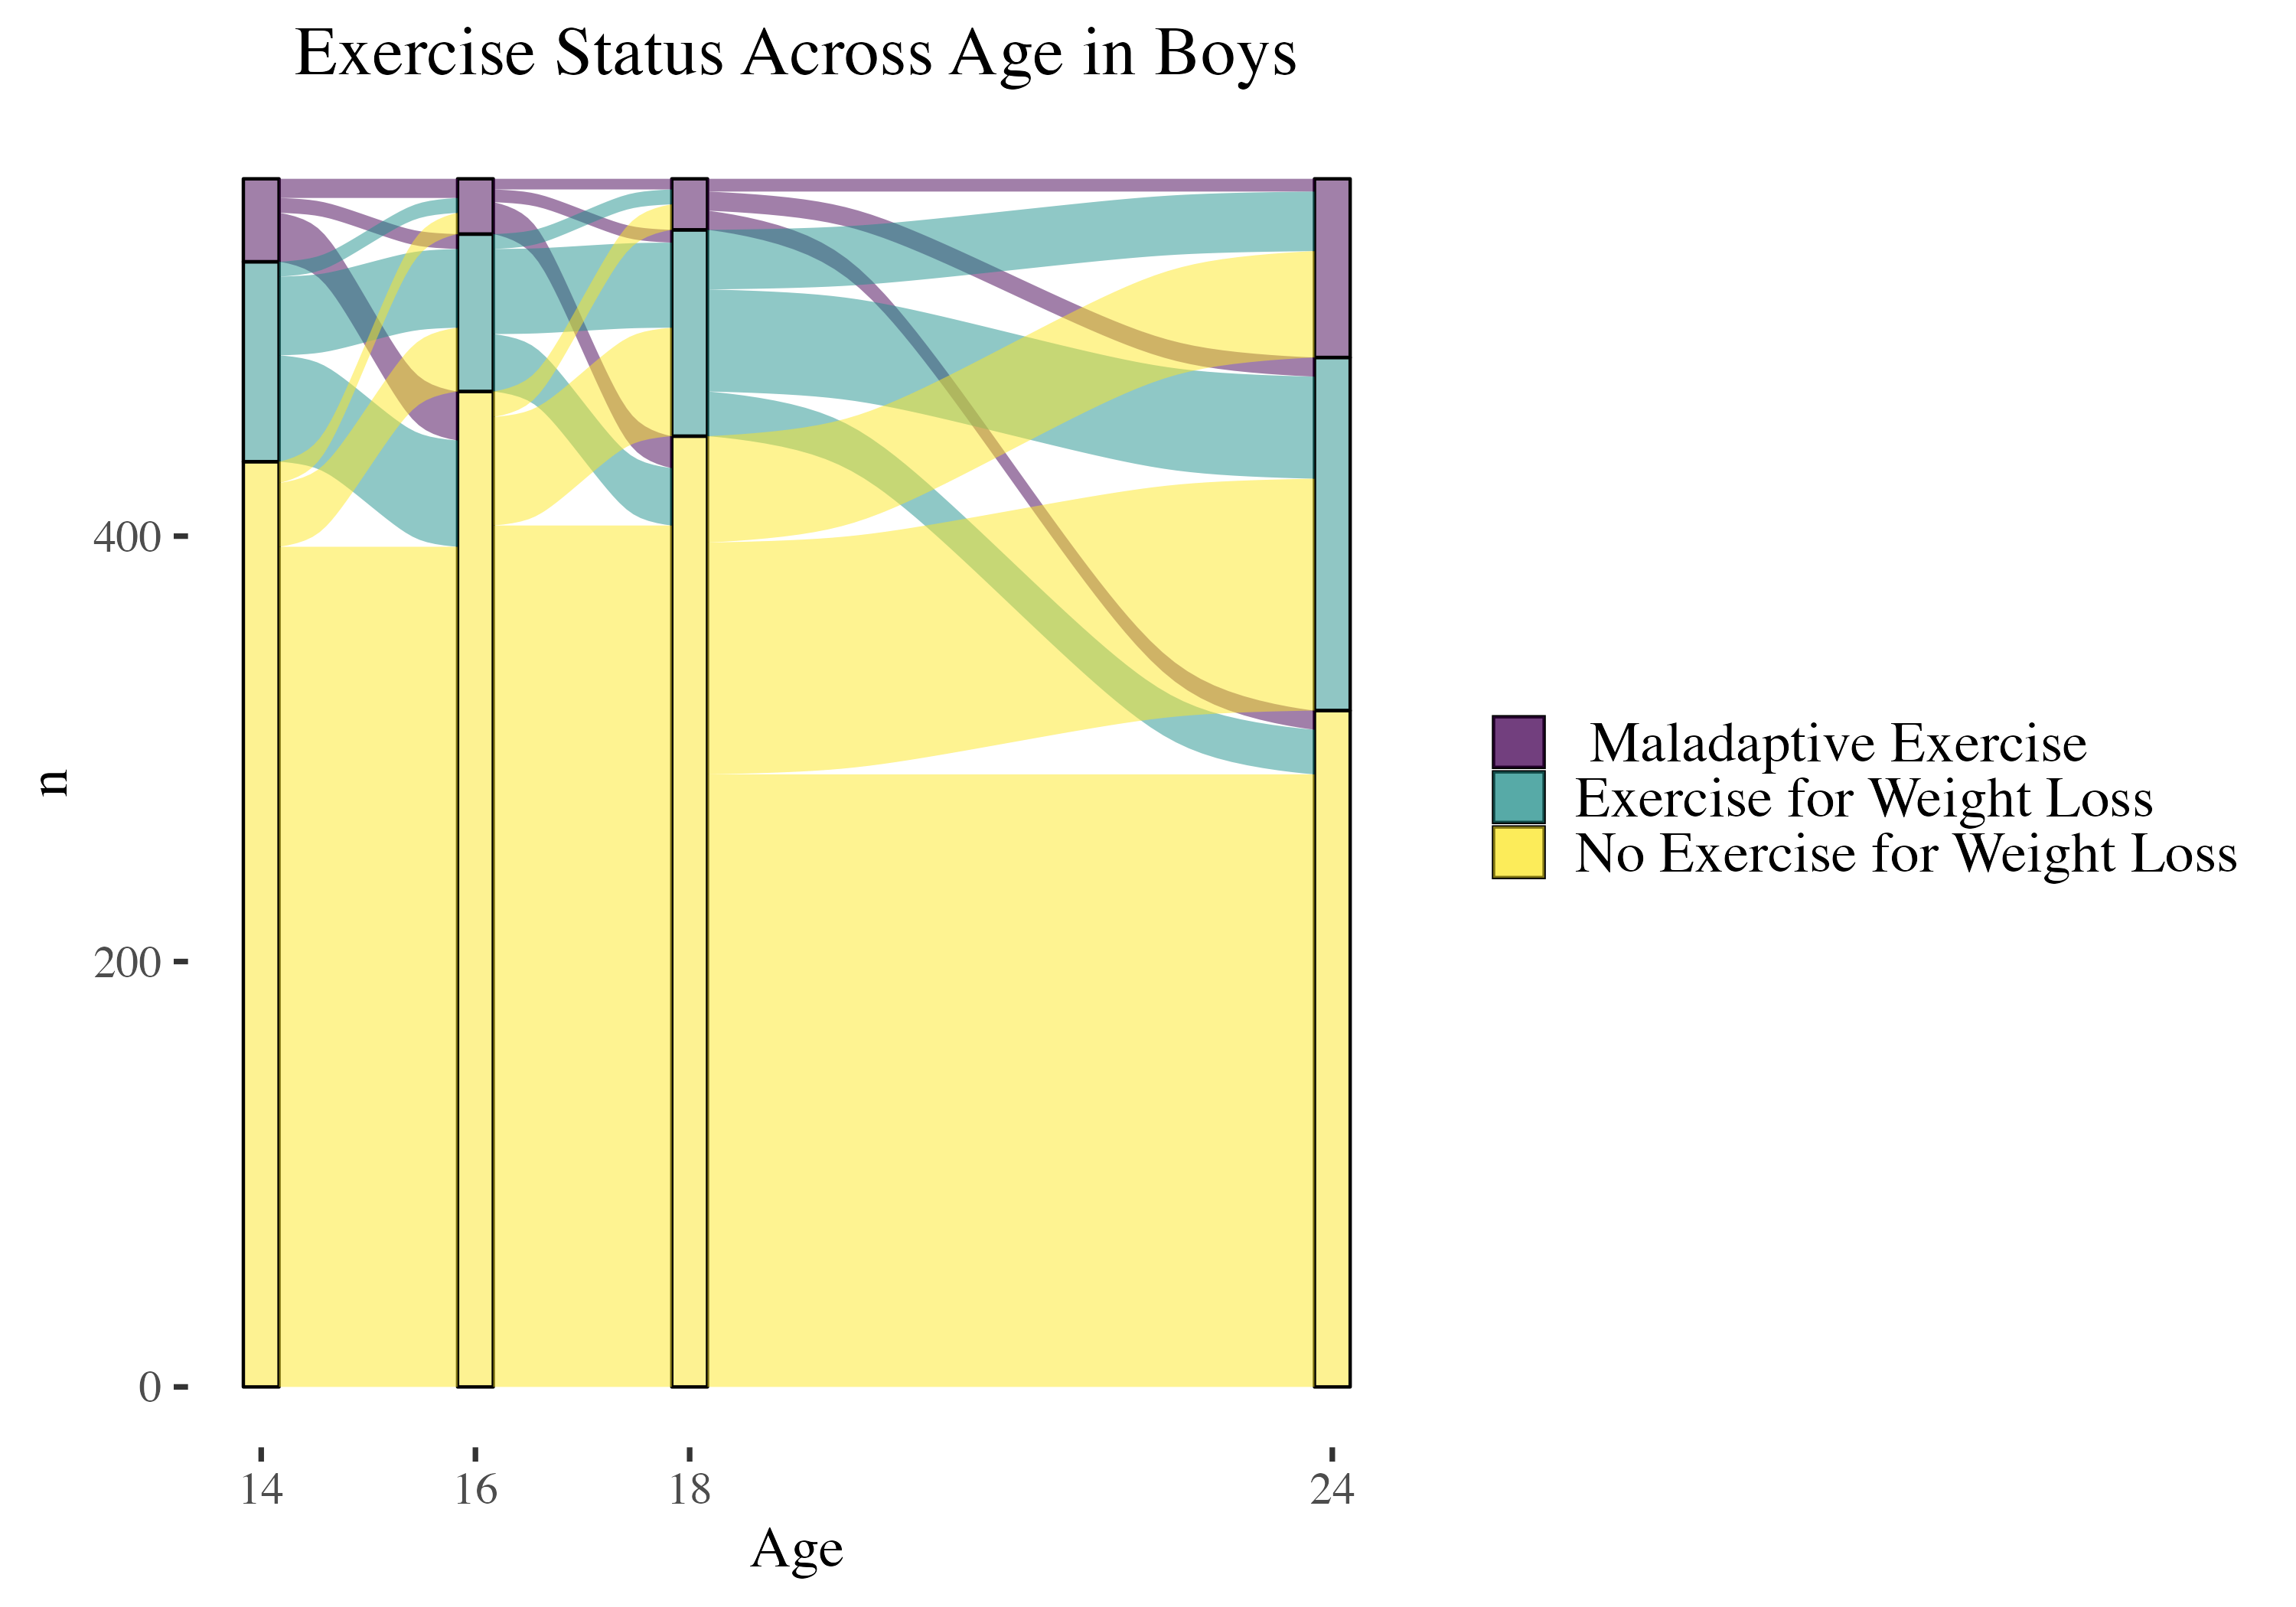
Estimates of Transition Probabilities Across 1-year amongst Boys: From (rows) - To (cols)
 | No EWL | EWL | Maladaptive Exercise
No EWL | 0.90 | 0.09 | 0.01
EWL | 0.20 | 0.63 | 0.17
Maladaptive Exercise | 0.19 | 0.18 | 0.63

Slide 17
Associations with Maladaptive Exercise: Demographics and baseline (Age 14) ED cognitions
Predictor | Girls | Boys
(Intercept) | 0.06 | 0.03
Age | 1.10 | 1.10
Parent SES | 1.02 | 1.00
BMI Z - Age 13 | 1.18 | 1.74
Fear of Wt Gain - Age 14 | 1.80 | 1.89
Body Dissatisifaction - Age 14 | 1.12 | 1.01
Thin-ideal Internalization - Age 14 | 1.15 | 1.19
Age x BMI (13) | 1 | --
Age x Fear of Wt Gain (14) | 0.98 | --
Age x Body Satisfaction (14) | 0.99 | --
Age x Thin-Ideal Internalization (14) | 0.99 | --
D₃ stat (LRT vs. simpler model) | 4.75 | 21.10
Multiple imputation; multi-level modeling of maladaptive exercise and exercise for weight loss across adolescent development
Continuous predictors standardized; bootstrapped 99.5% confidence intervals

Slide 18
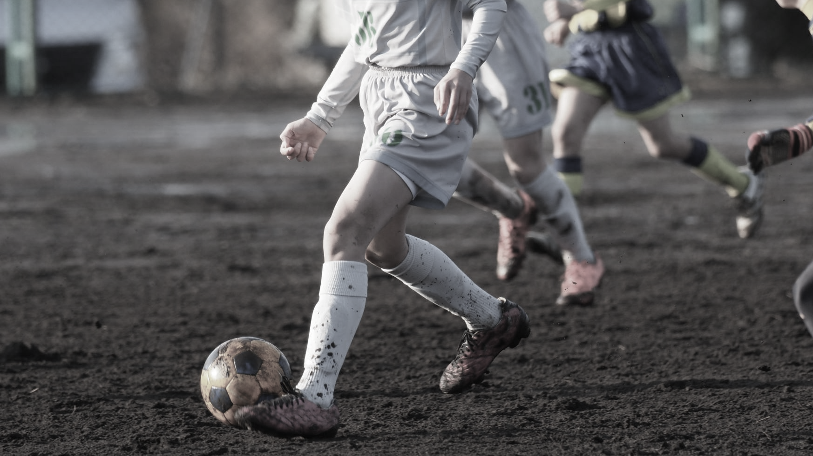
Discussion
.
Both EWL and maladaptive exercise increase in frequency across development
Fear of weight gain and high BMI are associated with maladaptive exercise in this adolescent cohort
EWL and Maladaptive Exercise in early adolescence may be useful in models identifying high-risk youth
Notes:
Cross-sectionally - driven exercise demonstrated the strongest relationship to current ED features support the psychological component of drive to exercise may be primary to defining dysfunctional exercise risk.

Slide 19
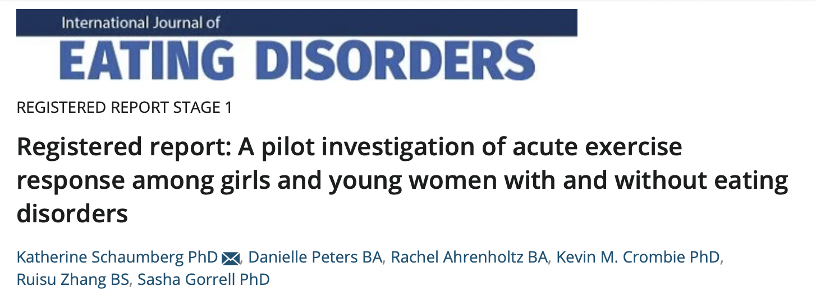
Aim 1: Confirm feasibility of paradigms evaluating acute response to exercise among outpatient individuals with EDs. a) study dropout, b) adverse events, c) completion rates of exercise task on Day B, d) completion rates of milkshake task across ED and HC participants.
Aim 2: Characterize variability in biobehavioral response to in-lab exercise. Characterize changes during exercise in state body image, mood, and biological markers in both ED and HC groups; specifically mean levels of, and variability in, biobehavioral response to exercise across ED and HC.

Slide 20

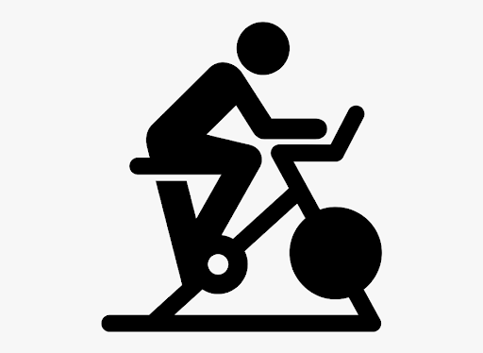

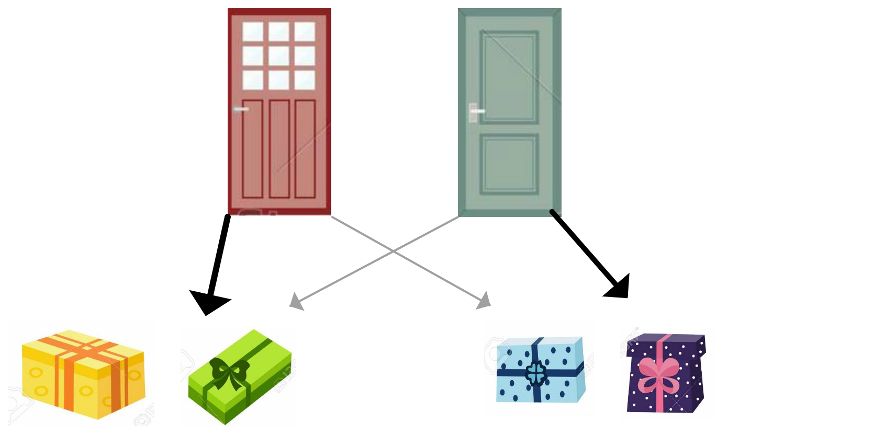

Participant flow through study
DAY A: Prescribed Exercise Task - Rest Condition; Self-Paced Exercise - Exercise Condition
DAY B: Prescribed Exercise Task - Exercise Condition
Self-report
30-min Prescribed Exercise
Affect
Body Image
Self-report
Self-report
Self-report
Affect
Body Image
30-min Rest
Affect
Body Image
Affect
Body Image
Biomarker
Behavioral
Biomarker
Behavioral
DA, eCB, 5-HT, leptin, cortisol
Work for $
DA, eCB, 5-HT, leptin, cortisol
Work for Exercise
Behavioral
Self-report
Behavioral
Affect
Body Image
Self-report
Markov Task
Markov Task
Biomarker
Affect
Body Image
Biomarker
DA, eCB, 5-HT, leptin, cortisol
DA, eCB, 5-HT, leptin, cortisol
30-min self-paced activity
DAY C: Self-paced Exercise Task - Rest Condition
HR
Distance
Exertion
Affect
Body Image
30-min rest
Self-report
Affect
Body Image
Affect
Body Image
State Measures:
Affect
Body Image
Note. Day A-C order is randomized. Accelerometer-measured free-living activity; self-reported DEx; ED symptoms; anxiety and personality measures collected at screening
Notes:
Acute exercise response
-Intro importance of exercise in EDs; significance; need to better understand for treatment how, how much, for whom.
-Not all individuals with EDs report DEx
-Amount of exercise not as important as psychological relationship with Ex
-we want individuals with EDs to be able tot have more normative relattionsihps with ex
-two main mechanisms that may influence risk for DEx, which I’ll talk about more on the next slide-threat and reward
Day A
Progressive ratio task – 50, 100, 250, etc. for $3
“exercise reward task” – baseline reward responding
Markov – measure of reward response that requires model-based learning and PFC engagement
Ex threat task – for many people getting to drink a milkshake is exciting, not necessarily for those with EDs,
This would be a threatening experience
Engage threat-based systems
Remember back to my job talk – fear and anxiety are relevant for eating disorder risk and maintenance. And the core/central fear among EDs is fear of weight gain.
This task is designed to specifically engage this fear of weight gain
Determine response to this disorder-relevant, threat-based engagement
Determine how effective exercise is in reducing self-reported negative affect and body image

Slide 21
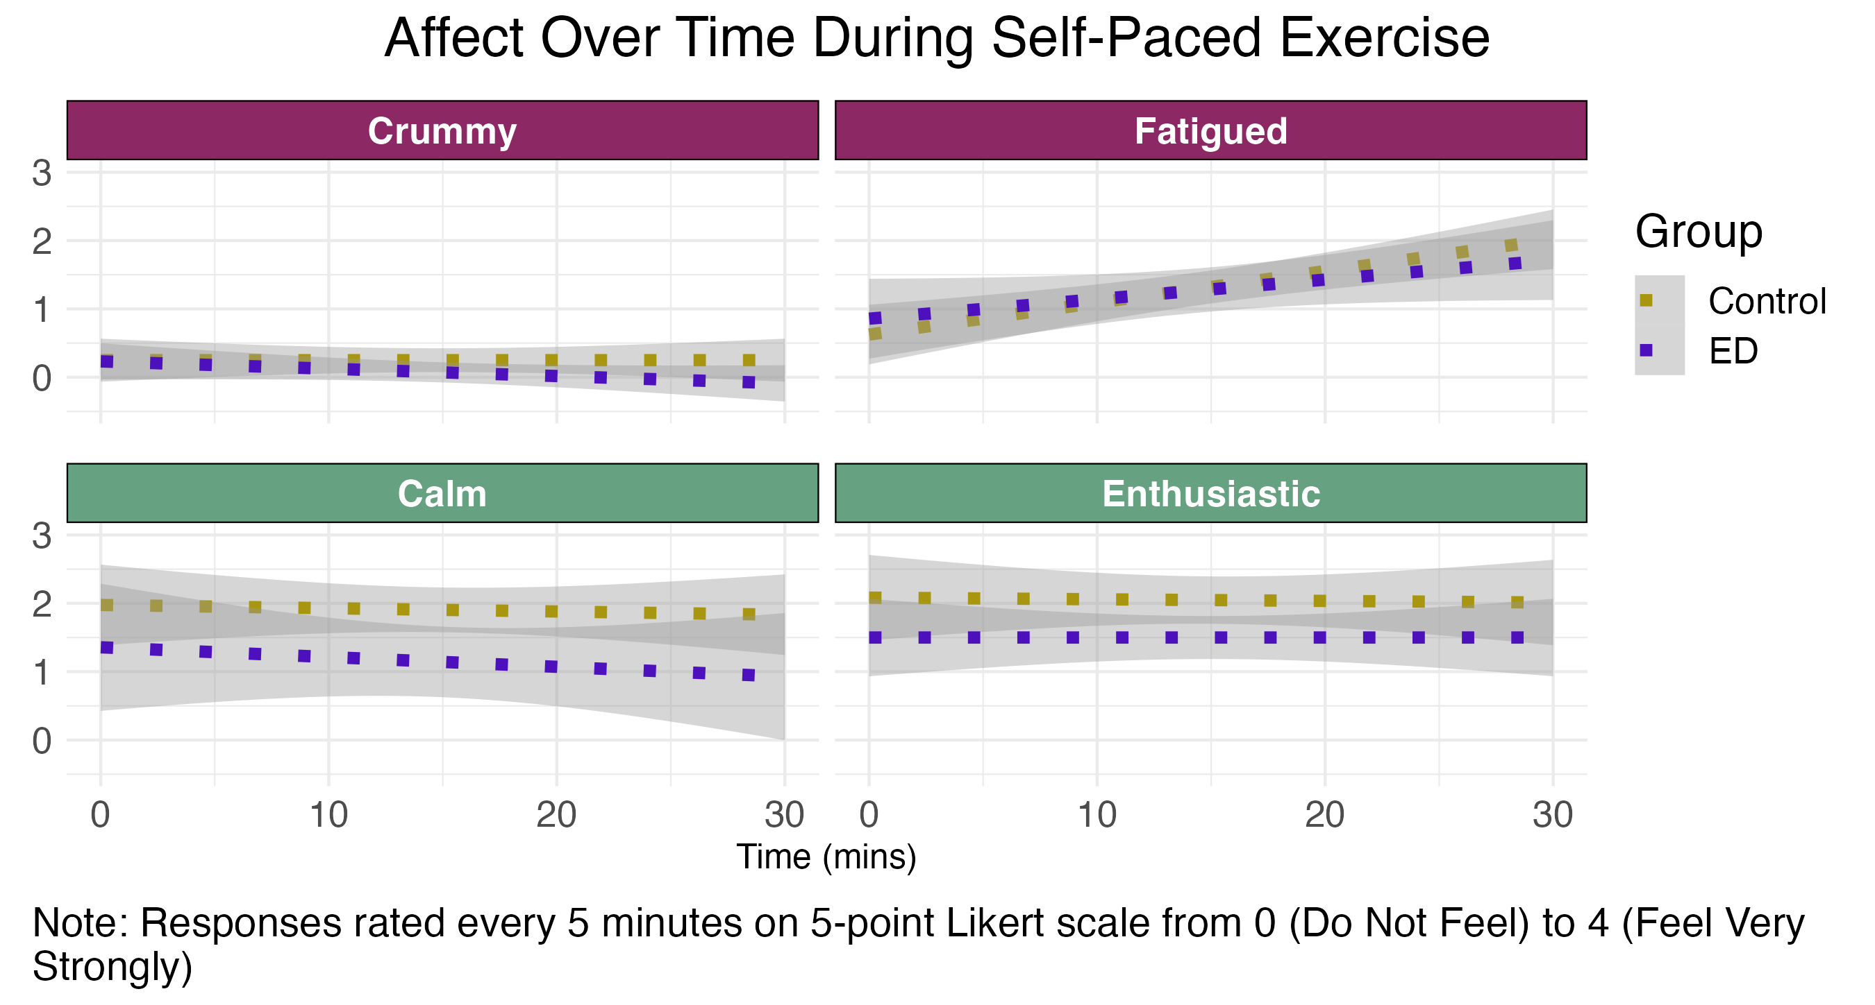

Slide 22
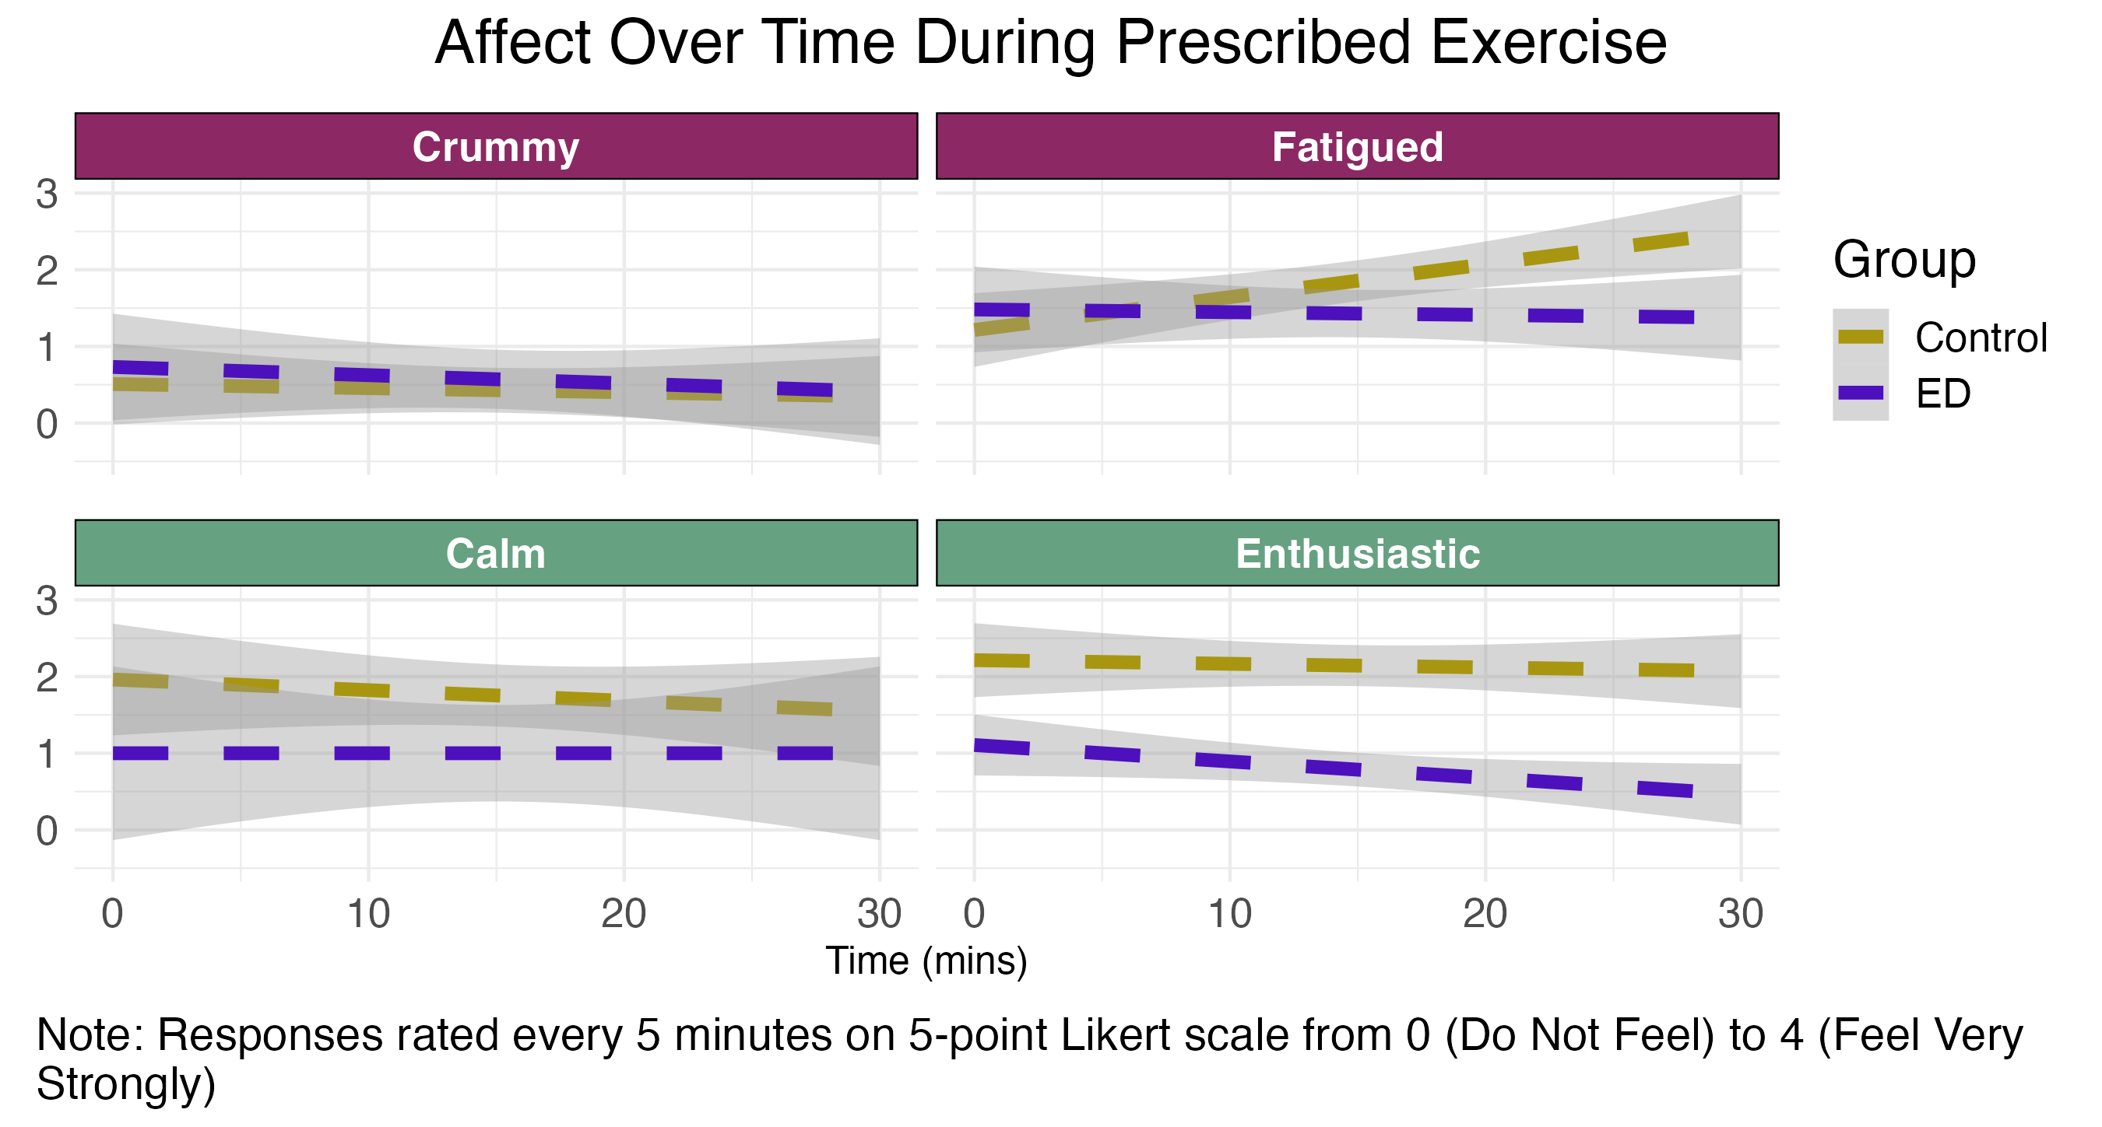

Slide 23
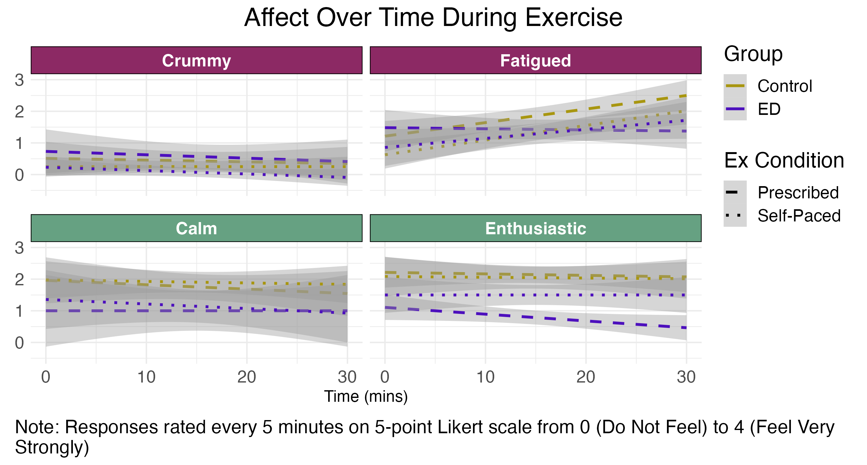

Slide 24
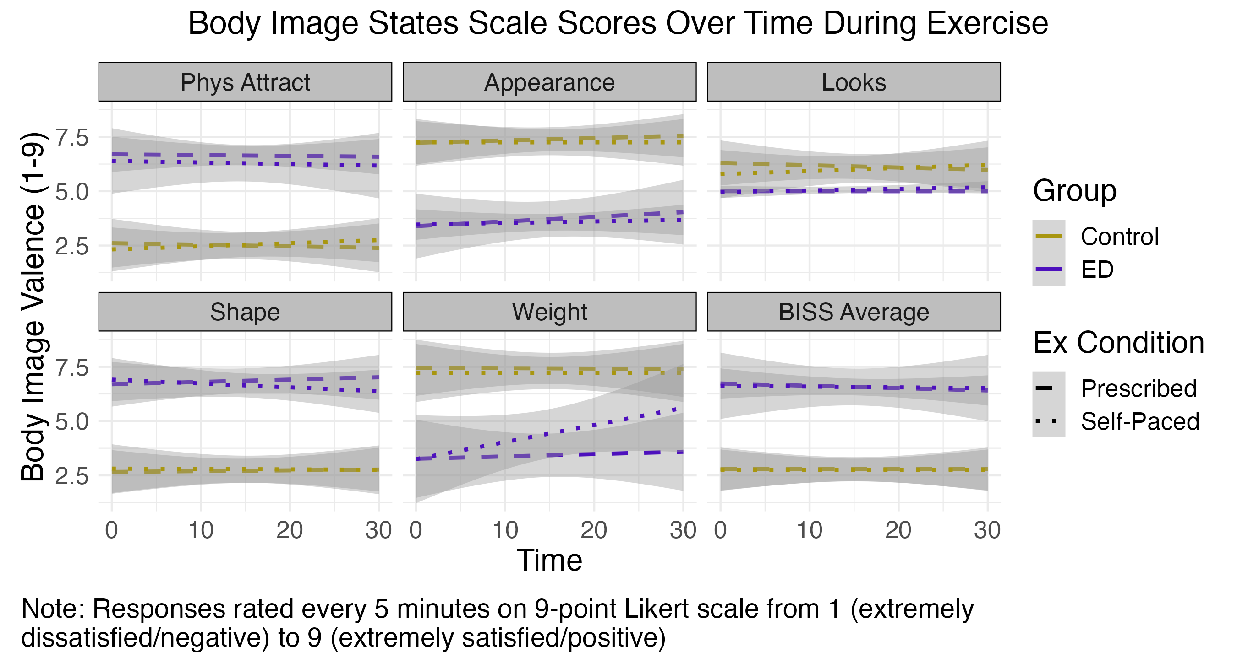

Slide 25
Preliminary Results
N = 37 (23 HC; 14 ED[6 subclinical; 6 partial recovery; 2 active])
Both self-reported compulsive exercise (HC vs. ED d = 2.08) and exercise intensity [mean pre-post HR change HC: 44(SD = 17); ED: 66 (SD =22); d = 1.10 ] during self-paced task suggest HC/ED differences in drive to exercise

Slide 26
Those with high levels of anxiety + internalized weight—related fears who experience restriction and exercise as psychobiologically reinforcing may be at high eating disorder risk

Slide 27
Exercise Prescriptions

Slide 28
Part 2: Data-forward screening and intervention to prevent entrenchment of maladaptive eating and exercise

